Slide 1

Fellowship of the Heart
Getting Started — the Four Connects, walked around the table on alternating evenings
Evening Series 2026–27 · at the Tittle home · v1.5E DRAFT
All Scripture: ESV · The Companion lesson plans carry the full scripts — these slides carry the room
1
Notes:
DECK TITLE · pre-session · DIVIDER
On screen as the room assembles on night one. All Scripture ESV; the plans carry the scripts; these slides carry the room — and these notes carry you.

Slide 2

SESSION 5
Knowing and Being Known
The four conditions of a container, applied to your real friendships
Quarter 1: Connect with Self & Others
66
Notes:
S5 · pre-session · DIVIDER
On screen through dinner and as the circle forms. Greet at the door — the slide holds the room.

Slide 3



Where We Are — the Four Connects
Session 5 stands in the second box — Connect with Others. The four conditions of friendship are how connecting with others can be a basis for loving others (Matt. 22:37–40).
67
Notes:
S5 · 7:00–7:08 · LEAD: CONTAINER HOLDER · GROUNDING — every session now opens on this map
BEATS:
1. Frame from the map: the first four weeks were Connect with Self — the soil, the story told all the way around. Today begins the second box: Connect with Others; two weeks here.
2. The four boxes are one journey — each connection makes the next one real — rooted in the two great commandments: love God, love neighbor (Matt 22:37–40).
3. Tonight makes visible the four conditions that have been quietly holding this room, and asks where they live in our actual friendships. The four conditions can be a basis for loving others — foundational, not exhaustive: there is more to loving somebody than these four (the wrap-up slide names it).
CUES: This is also the 'where we are on the map' minute the welcome owes any newcomer. A sibling of this slide opens every session going forward.

Slide 4

Session 5 — Tonight’s Road
1 Welcome and centering
2 Check-in — the homework practice since we last met
3 The four conditions — teaching
4 Bridge to split
5 Friendship-mapping exercise
6 Merge and surface common patterns
7 Homework commissioning — handout + partners
8 The Leader Feedback Round — both leaders
9 Closing container
68
Notes:
S5 · 7:00–8:30 · BOTH LEADERS
BEATS:
1. Movement two begins: Connect with Others. Today names the four conditions that have been holding this room — Safe, Present, Clear, Intentional — then maps them onto real friendships in pairs.
2. Shape: open, check-in, 15-minute whiteboard teaching, bridge, 28-minute friendship-mapping, merge patterns, practice, feedback, close.
3. Risk profile is nearer Week 2 than Week 3 — but 'I don't have a single friend who knows me' from a teen is its own quiet emergency; receive it and follow up within 48 hours.
CUES: Whiteboard pre-written vertically: SAFE / PRESENT / CLEAR / INTENTIONAL. Opening parent arranged per cluster.

Slide 5
Opening Container — the Eight Steps
1 Welcome — five minutes to open the container
2 Phones silenced and put away
3 Stand in a circle
4 One-word check-in — how you actually are, right now
5 Put out / bring in — set something down; bring a blessing in
6 Spoken commitment: “I am here. I am paying attention. I am willing to be moved.”
7 Opening prayer — “Holy Spirit, you are welcome here. Speak. We are listening.”
8 Sit. Begin.
69
Notes:
S5 · 7:00–7:08 · LEAD: CONTAINER HOLDER
BEATS:
1. Blessing over the room; let it settle first.
2. Name the leading pair: two leaders hold tonight — one holds the container, one presents the content — and you will see the evening handed back and forth between them. That is the design.
3. Container reminders, briefly: what is said here stays here; nothing required; we listen to receive, not to fix.
(The Four Connects framing now lives on the map slide that follows.)

Slide 6

Check-In — the Homework Practice Since We Last Met
• “Some of you got to it. Some didn’t. Both are fine.”
• “Anyone want to say one sentence about how that landed for you?”
• Receive without commentary
• “Good. Some of that work continues whether or not we got to it.”
70
Notes:
S5 · 7:08–7:25 · LEAD: CONTAINER HOLDER
BEATS:
1. Check on the homework practice since we last met, and the midweek reports: one sentence each; a parent starts the sharing.
2. Take 3–4 voluntary contributions; receive without commentary.
3. Move on: 'Some of that work continues whether or not we got to it this week.'

Slide 7
Friendship Mapping with Four Conditions
1 SAFE — the hearing condition. “I will not be judged as a person while I am doing my work” — Romans 14:3–4
2 PRESENT — the attention condition. “I am actually here” — aware that the Great I AM is also here — Revelation 1:8
3 CLEAR — the channel condition. Nothing unaddressed between God and me, or the circle and me — Matthew 7:5
4 INTENTIONAL — the obedience condition. On purpose, watching for what God is doing, willing to do it — John 5:19
ECCLESIASTES 4:9–12
“Two are better than one, because they have a good reward for their toil. For if they fall, one will lift up his fellow. … And though a man might prevail against one who is alone, two will withstand him—a threefold cord is not quickly broken.”
71
Notes:
S5 · 7:25–7:42 · LEAD: CONTENT PRESENTER
OPENING LINES (moved from the slide): The threefold cord is stronger because the strands hold each other in tension — the strength is in the holding.
Four conditions have been quietly holding this room for four weeks. Tonight we name them.
BEATS:
1. Read Ecclesiastes 4:9–12 — the threefold cord's strength is in the holding.
2. Walk each condition 2–3 minutes at the whiteboard: SAFE, the hearing condition (not judged while doing my work — Rom 14:3–4); PRESENT, the attention condition (actually here — Rev 1:8); CLEAR, the channel condition (nothing unaddressed — Matt 7:5); INTENTIONAL, the obedience condition (willing to do what He shows — John 5:19).
3. Name the small-number frame: we are proposing deep investment in a SMALL NUMBER of friendships — starting with one; at this depth, two or three may be all a life can honestly hold. Tonight we work on one friendship and one condition, to get started at this deeper level.
4. Teach lightly — the pairs exercise does the depth work.
GUARD: This is not friendship tips. Stay with the four conditions as defined, and do not run long — the mapping block needs its full 28 minutes.

Slide 8
Bridge to the Split
• Each pair takes the four conditions and asks: “for each one, where in my actual friendships does this show up? And where is it missing?”
• “We are not naming names tonight. ‘One of my friends’ is fine.” — we map conditions, not people
• A leader models each condition first, then one of the parents opens the round
• Teens, you choose your own depth. Pass anytime
• Twenty-eight minutes — in pairs, right where you sit
72
Notes:
S5 · 7:42–7:43 · LEAD: CONTENT PRESENTER · TRANSITION
BEATS:
1. Frame the exercise: for each condition — where does it show up in my actual friendships, and where is it missing? Worksheets are on the chairs.
2. Name the language rule: no names — 'one of my friendships,' 'one adult relationship in my life.'
3. Pray and send: in pairs, right where you sit; back together at 8:08. Ten or fewer can also stay one circle.
SMALL ROOM: the split is only necessary if the room is large enough to need it. With six or so, stay one circle — or the quick pair work in place, knee to knee. Pair work is also the standing time-recovery lever: a full split-and-merge costs about five minutes.
CUES: A leader models each condition first, then the arranged parent opens; teens choose their own depth after; pass anytime.

Slide 9

Friendship-Mapping in Pairs
• Four conditions, about six minutes each — a leader models first, a parent opens the round
• Each turn 30–60 seconds — specific: one friendship where the condition is present, one where it is missing
• “No names of people who aren’t in this room — and for people who are, ‘one of my friendships’ or ‘one adult relationship in my life’ is the language. Nobody asks who you meant.”
• Parents map their own adult friendships — not their teens’
• If time remains, the quiet final question: “Of the four conditions, which one is the one I find hardest to offer to my friends?”
73
Notes:
S5 · 7:43–8:08 · PAIRS · LEAD: CONTENT PRESENTER; container holder watches
BEATS:
1. About six minutes per condition: a leader models 30–60 seconds (one friendship where it is present, one where missing — specific), a parent opens, then around; pass allowed.
2. After each round the Companion names one observation and moves on — no summarizing, no evaluating.
3. Finish early: the harder question, silent, two minutes — which condition am I hardest at OFFERING?
CUES: Minute four with three unspoken — compress: 'Two minutes left on this one, quick rounds.'
GUARD: Real names get gently re-framed. The relationship a teen maps may be the parent beside them — hold the anonymous frame both ways: nobody asks who was meant, in the circle or afterward. A teen with no friendship in any condition: receive, do not rescue, flag for the Lead Companion. Parents map their OWN friendships, not their teen's.

Slide 10
Merge — Surfacing Common Patterns
• What happened in your pair stays in your pair
• Patterns only — general, no names. Two questions, answered as a pair:
– Most common: which condition shows up most often across the friendships we mapped?
– Rarest: which condition is most often missing?
• Each pair offers one or two general patterns
• Then the container holder names one observation across the pairs — “that is real, and it is the seed of the practice ahead”
74
Notes:
S5 · 8:08–8:20 · LEAD: CONTAINER HOLDER
BEATS:
1. Patterns only, no people: each pair offers one pattern. Two questions, named clearly: which condition shows up MOST OFTEN across the friendships we mapped (the most common) — and which is MOST OFTEN MISSING (the rarest).
2. You close with one true observation across the pairs, briefly — the actual one, e.g. 'most of us name what is missing from our friendships faster than what we ourselves don't offer.'
SMALL ROOM: if the room never split, the 'pairs' are the pairs you worked in — patterns surface straight to the one circle.
GUARD: Pattern-level means pattern-level — nothing from any individual's mapping crosses cluster lines.

Slide 11
More Than the Four
• The four conditions are foundational — they are what make a close friendship possible
• But a good friend reaches you in more ways than these:
– They give you energy — you walk away from them uplifted
– They are warm and caring — and maybe even funny
• And these are a way to choose: which friendships do you want to deepen — with this process, and this intentionality?
75
Notes:
S5 · 8:18–8:20 · LEAD: CONTENT PRESENTER · WRAP-UP
BEATS:
1. Name it plainly: the four conditions are foundational — they are what make a close friendship possible. They are not the whole of friendship.
2. A good friend also reaches you in other ways: they give you energy — you walk away uplifted; they are warm and caring; maybe even funny.
3. Turn it toward choice: these other gifts are a way to think about WHICH friendships you want to deepen — with the process and intentionality we have just walked. As you work your one friendship these two weeks, notice what else your good friendships give you.
GUARD: Two minutes, riding the tail of the merge block — not a second teaching. The commissioning needs its time.

Slide 12

The Homework Practice — One Relationship, One Condition
• “Pick one relationship — a friend, a sibling, a parent, a teammate. Just one.” — you don’t have to tell anyone which one
– Deep investment in a small number of friendships — starting with one; two or three may be all a life can hold
• Pick one of the four conditions — the one most missing there, or the one you find hardest to offer
• Practice offering that one condition there, a little more than usual — what you give, not a test of them
– Presence — your phone is in another room. Clear — name something you have been quietly carrying
• If it stirs something hard: choose an easier one, or set it down for a few days — and tell someone you trust
• End of week one: report to your partner. Week two: same relationship or another, second condition — or deeper
76
Notes:
S5 · 8:20–8:24 · LEAD: CONTENT PRESENTER
BEATS:
1. Pick one relationship — a friend, a sibling, a parent, a teammate; not necessarily the closest; yours alone, told to no one. Pick one condition: the most missing, or the hardest to offer.
2. The small-number frame, restated: this is deep investment in a small number of friendships — starting with one. Not a program for your whole contact list.
3. Practice offering it more intentionally than usual over the two weeks — what you give, not a test of them; how they respond is not a grade on you — give the concrete versions: phone in another room for Present; receive without judging for Safe; name a carried thing for Clear; come in watching for what God is doing for Intentional.
4. The homework practice in writing: the Week 5 pages have journal prompts; H5.5 carries the practice. At the end of week one, report to your check-in partner.
5. Say the on-ramp plainly, warmly: looking at friendships can bring up loneliness, a friendship that hurt, or one that faded. Notice it; don't fix it this week. Choose an easier relationship or set the practice down for a few days, and tell someone you trust — your partner, a parent, one of us. The sheet says it too.

Slide 13
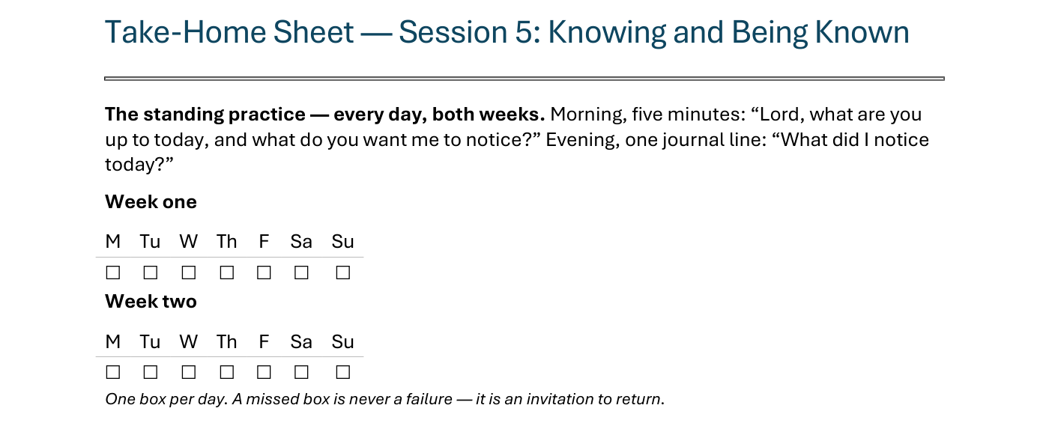
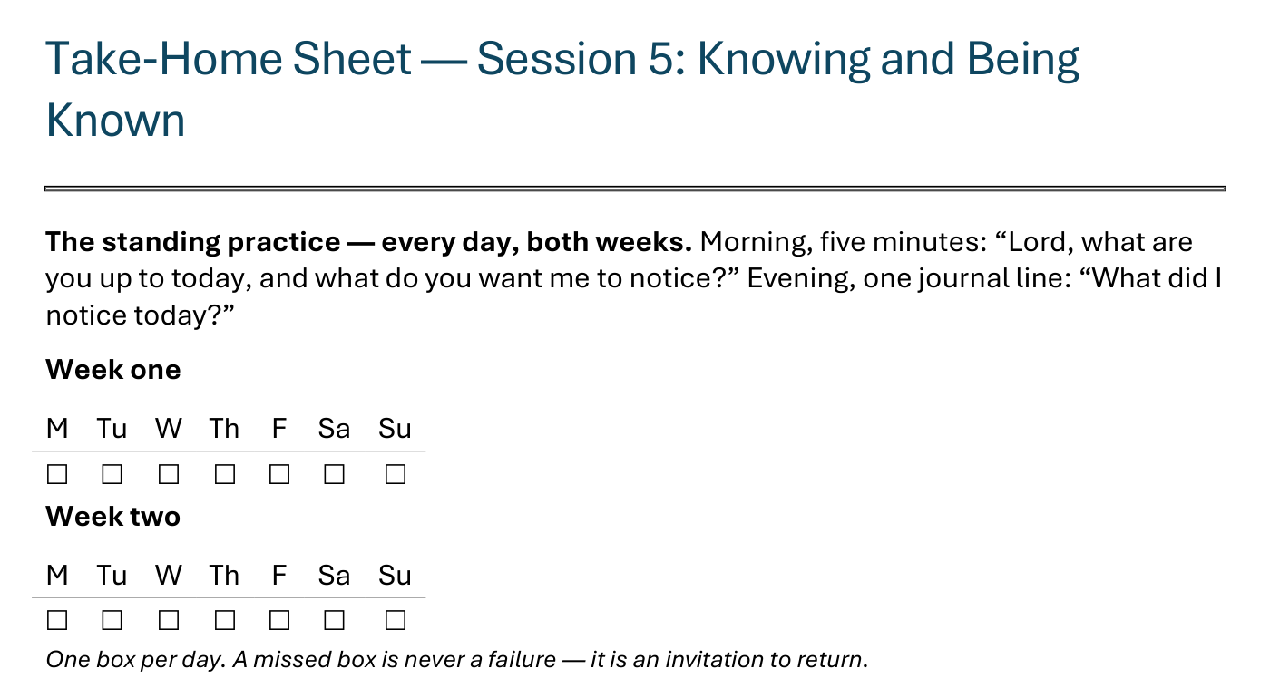
The Take-Home Sheet — the Daily Rhythm
Handed out now — this is the sheet in your hands.
77
Notes:
S5 · 8:20–8:24 · LEAD: CONTENT PRESENTER
BEATS:
1. The sheet on the screen is the sheet in their hands — walk it, don't read it.
2. The standing practice first: the morning question, the evening journal line — every day, both weeks; one box per day on the two week-grids.
3. A missed box is never a failure — it is an invitation to return.
CUES: Rides inside the commissioning block; the four parts are the next slide.

Slide 14
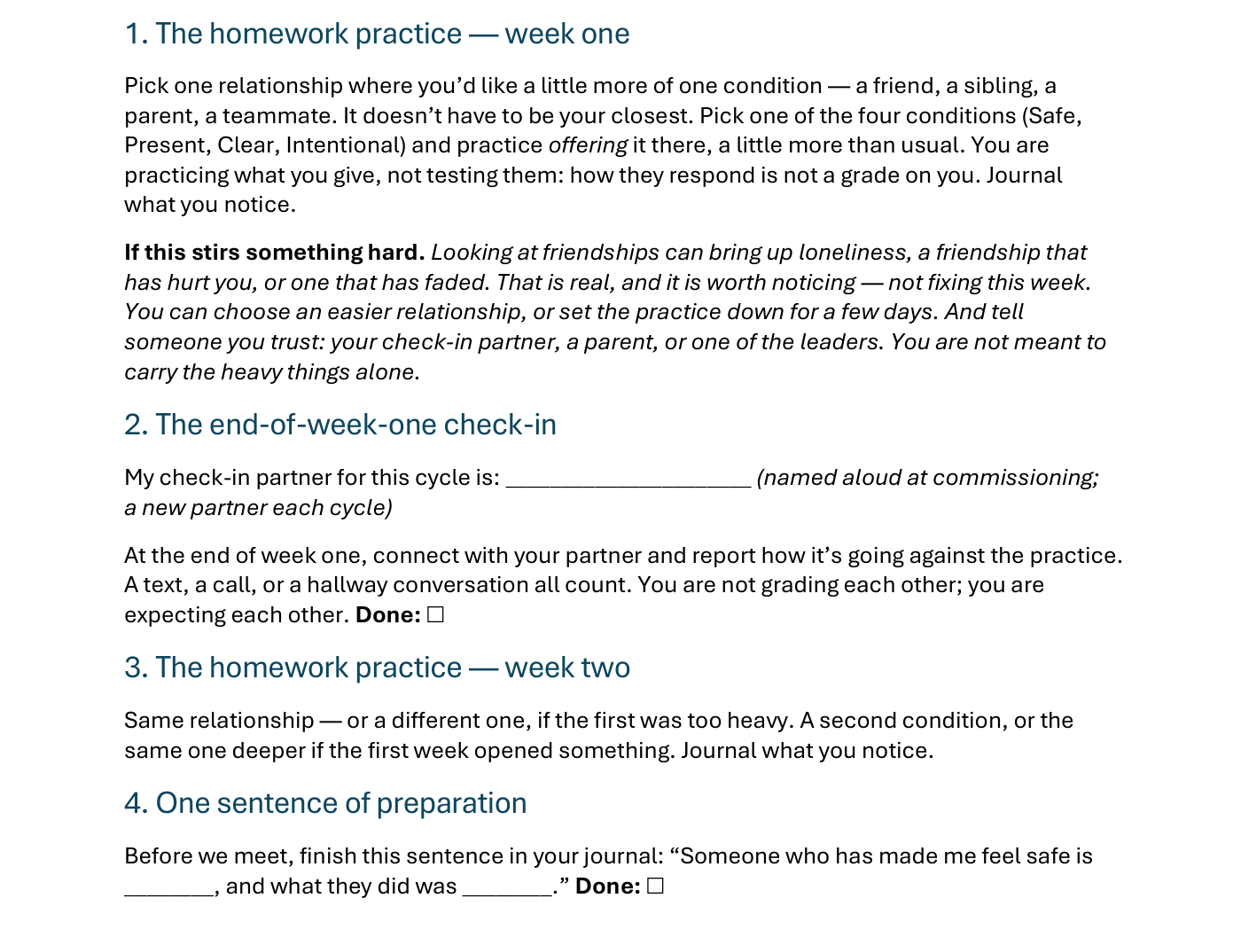
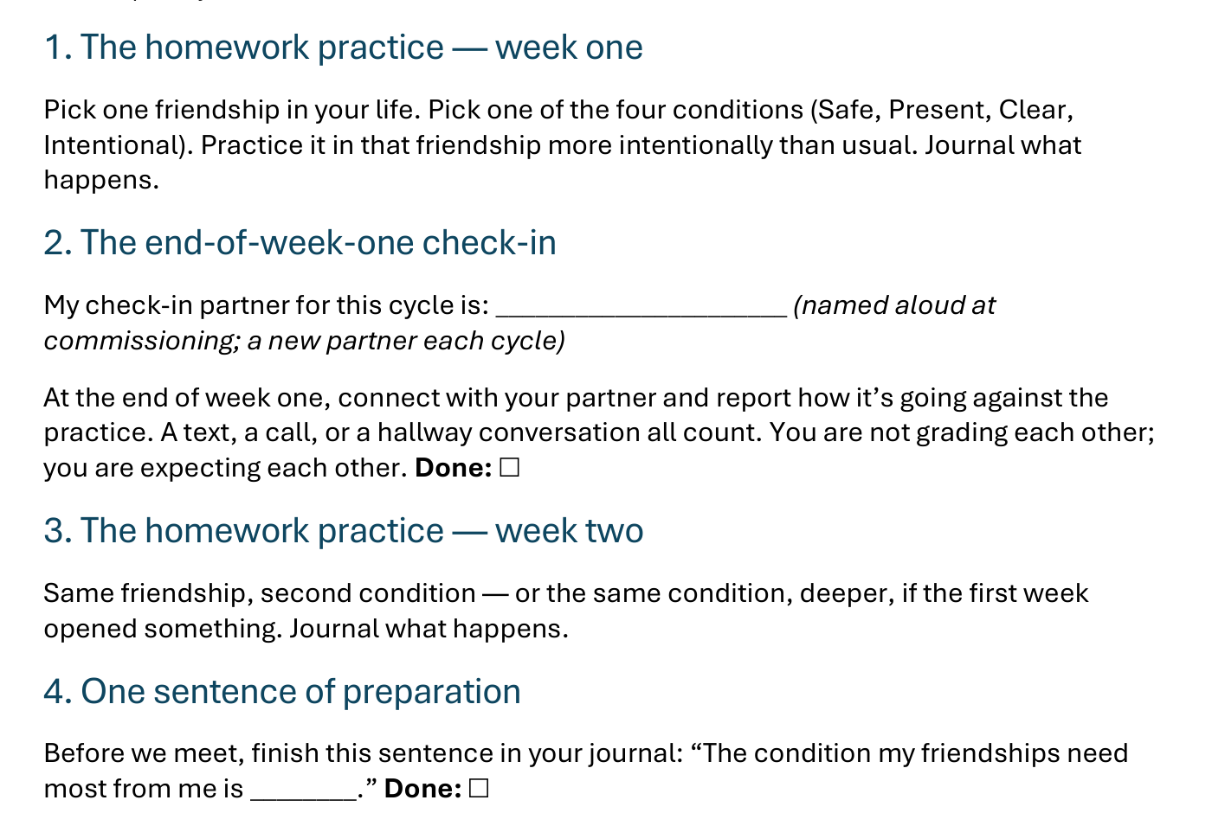
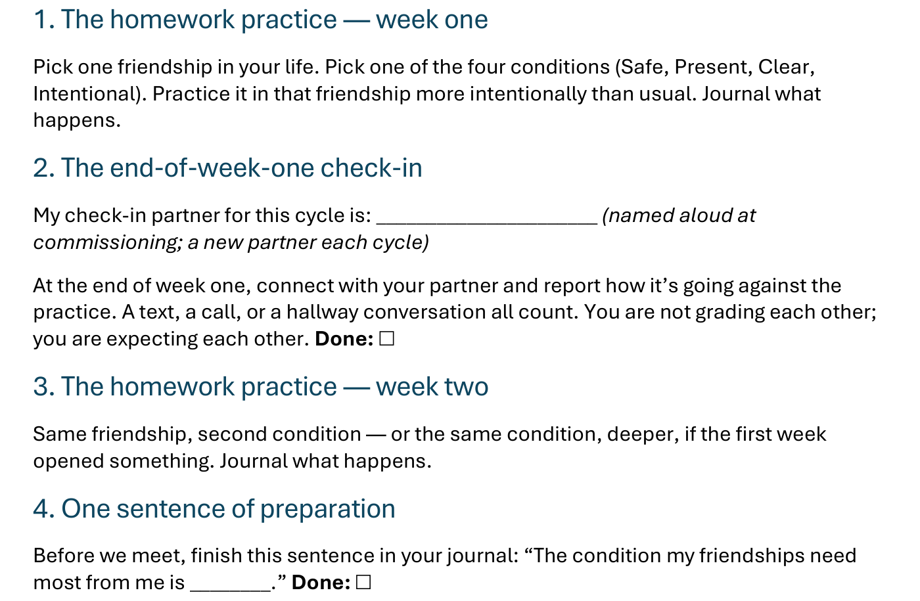
The Take-Home Sheet — the Four Parts
One relationship, one condition, offered — and a partner expecting you at the end of week one.
78
Notes:
S5 · 8:20–8:24 · LEAD: CONTENT PRESENTER
BEATS:
1. The four parts, in order: the homework practice, week one (one relationship, one condition, offered — and the on-ramp if it stirs something hard); the end-of-week-one check-in; the homework practice, week two (same relationship or another, second condition — or deeper); one sentence of preparation.
2. Check-in partners are named aloud before leaving this slide — the sheet has the line to write the name.
GUARD: Do not reteach the practice here — the practice slide did that; this is the sheet-walk only.

Slide 15

The Leader Feedback Round
• Two rounds, same as every session — the container holder first, then the content presenter: three things each
– “What I think went well tonight: ______”
– “What I’d do differently next time: ______”
– “If I were to teach tonight’s process to someone, I would tell them: ______”
• Then the room — the same two questions about tonight
• The leaders receive without defending — “thank you” is the whole response
79
Notes:
S5 · 8:24–8:28 · LEAD: BOTH LEADERS
BEATS:
1. Two rounds: the container holder first, then the content presenter. Three things each: went well; do differently; what I'd tell someone teaching today's process.
2. Then the room's two questions; two or three voices is plenty.
3. Receive without defending — 'thank you' is the whole response.
CUES: May be dropped if the room needs something else; twice running goes to the team debrief.

Slide 16
Closing the Container + Aaronic Blessing
• We close the way we opened — the container, six steps:
1 Stand again — same circle, same posture as the open
2 One-word landing — compare it to your opening word
3 The one thing you are taking from tonight
4 The one practice — committed aloud, or modified to one you will actually keep
5 Blessings — eyes on the person, not the screen: say what is on your heart for them. Specific, witnessed, short
6 Closing prayer — and the Aaronic blessing, spoken over each other, face to face
THE AARONIC BLESSING — NUMBERS 6:24–26
“The Lord bless you and keep you;
the Lord make his face to shine upon you, and be gracious to you;
the Lord lift up his countenance upon you, and give you peace.”
80
Notes:
S5 · 8:28–8:30 · LEAD: CONTAINER HOLDER
BEATS:
1. 'What was named today is yours. The friendships you mapped are yours. Carry it gently.'
2. Name the open door: anyone who noticed they have no friendships with these conditions — reach out to the team; that is real, and not a problem to solve in five seconds.
3. Aaronic blessing. 'See you Wednesday.'
BLESSINGS: eyes on the person, not the screen — nothing to read; say what is on your heart for them, specific and short.

